Slide 1

Application: Service General Type: Application Architecture View: Logical View Style: Layered Architecture Pattern
Users
Deliver Channels
Core Business Processes
Data And Information
Technology Enablers
Create User Account
User’s Personal
E- Payment Vendors
Consumer
Internet
Browser
Service Search
Social Media
Job Service Data
Post Feedback
B2B Gateway
Location Data
Service Provider
Payment & Fee Transactions
Email
Service Invocation
Employee Data
Register Job Service
Directory Server
Book Job Service
Payment Information
Message Bus
Employees

Slide 2
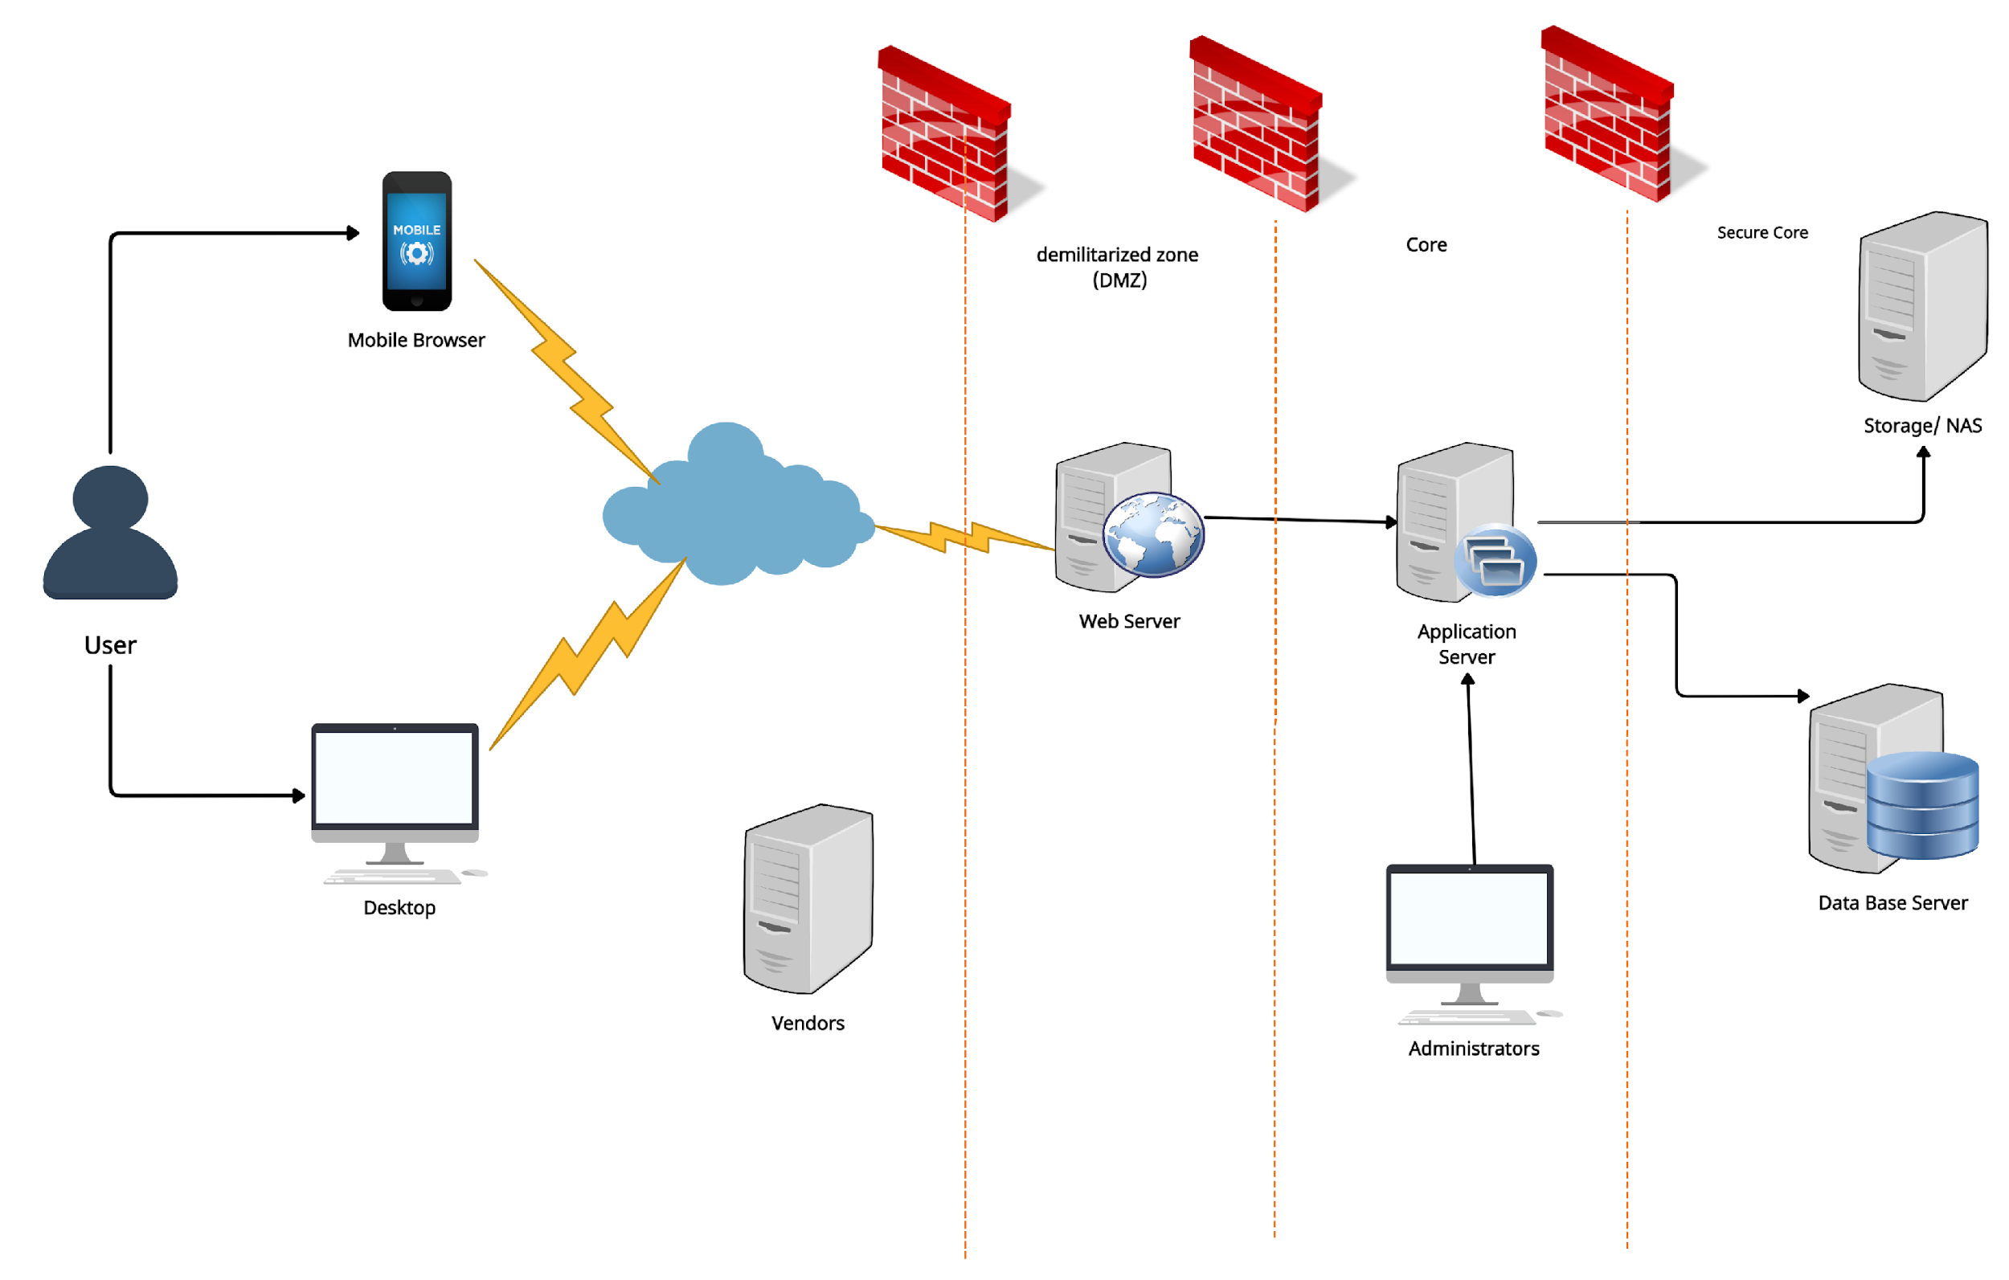
Application: Service General Type: Application Architecture View: Process View Style: Client-Server Pattern

Slide 3
